Slide 1
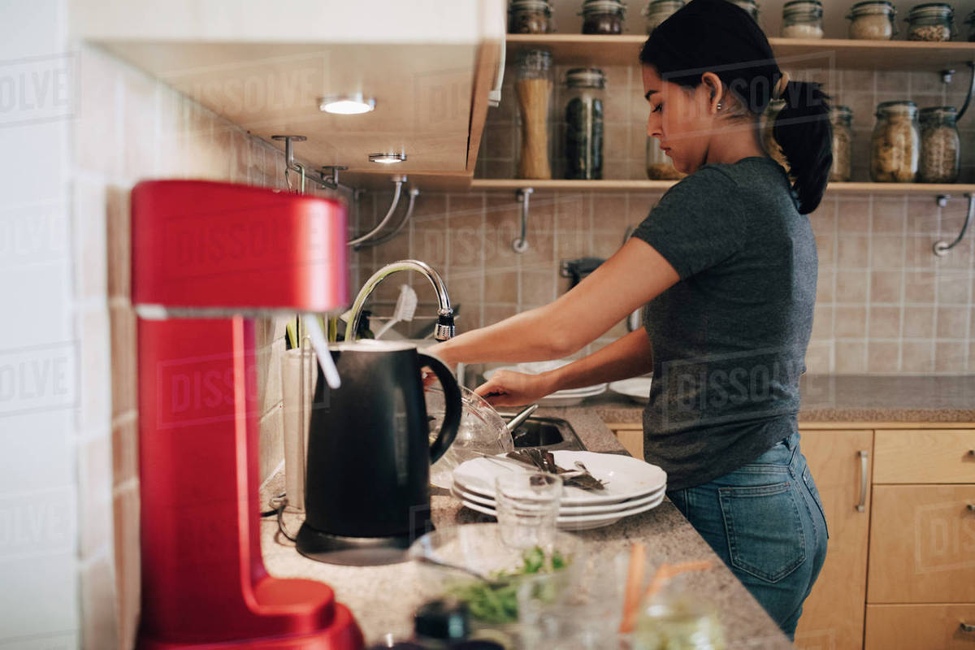
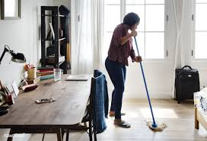
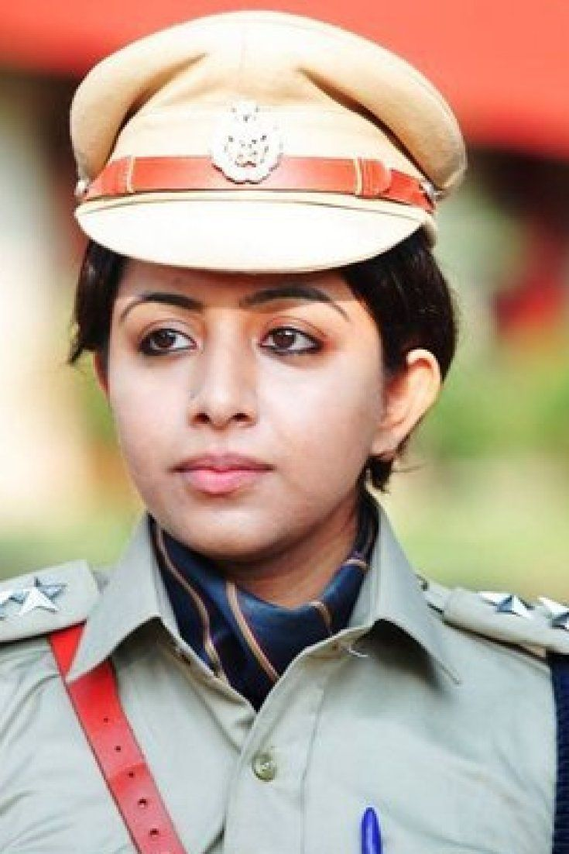
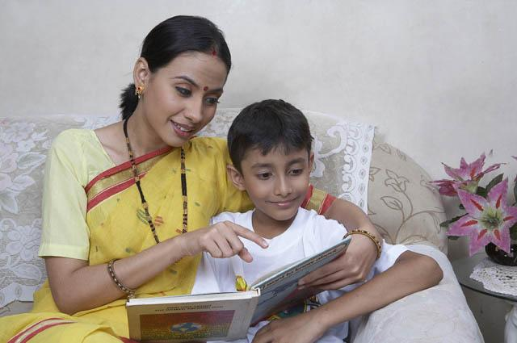
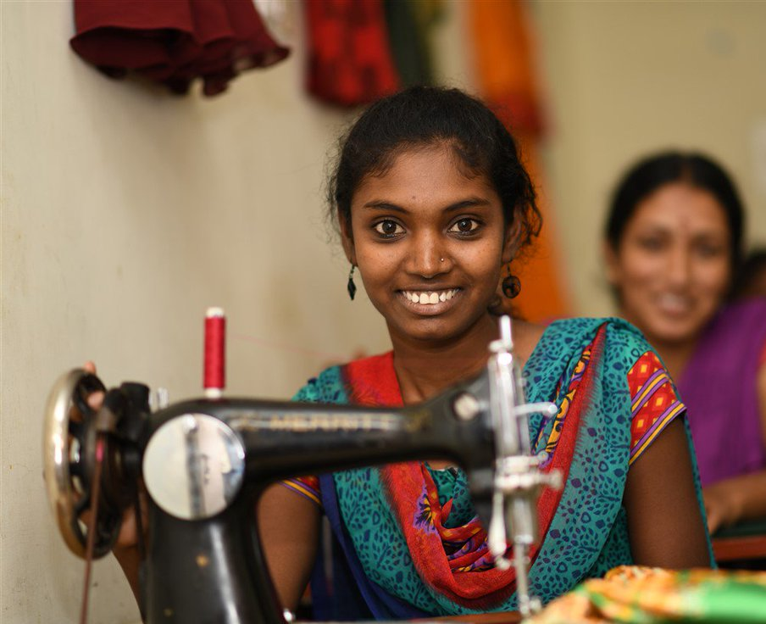
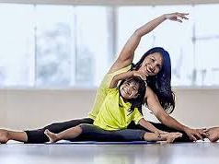
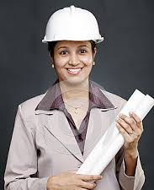
Many names, many personas, and many facets. Multitude of tasks that a women does. If she desire to achieve, nothing could stop her
#Brave&Beautiful

Slide 2
MARKET RESEARCH & OVERVIEW
The company expanded from online only to an omnichannel business model. It also launched it’s In-house brands: Nykaa Naturals & Nykaa Cosmetics
2012
2015
2020
Nykaa was founded by Falguni Nayar. It was launched as an ecommerce portal for beauty & wellness products.
With a CAGR of 151% and a valuation of $750 million Nykaa raised INR 100 crore from Steadview Capital in March

Slide 3
MORE ABOUT NYKAA
Products Sold over 3 lakhs in 2019-20
Average order value is approximately $17
8 min Average time spent per user on the App/Website
Revenue generated in FY 2019 is ₹ 1200 Cr.
Cross Category expansion (Nykaa Fashion, Nykaa Naturals, Nykaa Men grooming and others)
40 Million/month monthly visitors.
Advertising and Promotional Expenses are 96.14 CR
Information Technology expenses, website, SOE and other expenses are 20 Cr
95% online sales, better reach during the pandemic
10% Revenue
generation from its Private Label Brand

Slide 4
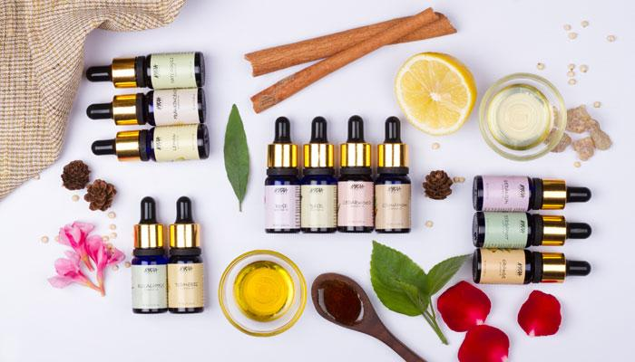
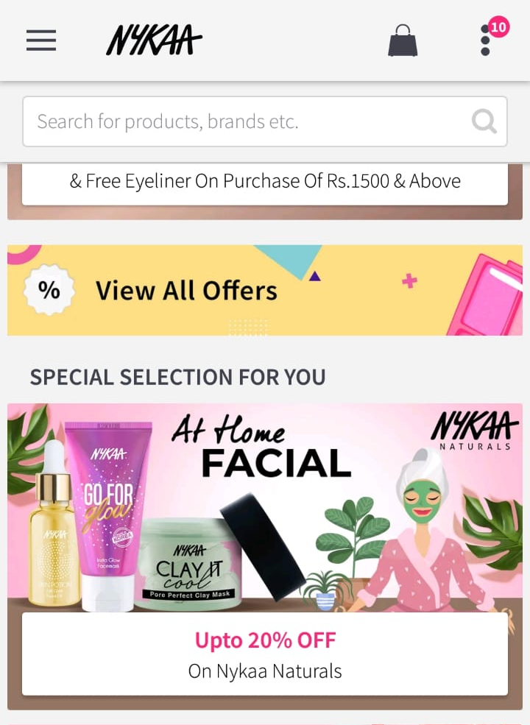
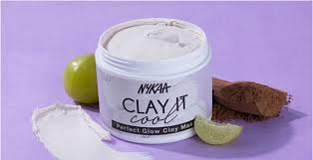
Nykaa
Naturals
Nykaa Naturals is known for it’s composition which is chemical free. They come in a large number of variety suiting different types of Indian skin thus spreading it’s reach to all kinds of customers.
The Wanderlust collection is a part of the daily essentials which is a must have in all women’s dressing table.
The sheet masks and Clay It crème give a natural glow to the face and reduces a consumer’s visits to the salon.
Nykaa Naturals also introduced different types of masks made from cloth / the medical N-95 mask and hand sanitizers in the view of the Pandemic.

Slide 5
TOP SOCIAL NETWORKING SITES
MARKET SHARE
E-COMMERCE
INDUSTRY
3.3M
9.9L
1M
COSMETIC
INDUSTRY
SKIN &
BODY CARE
FMCG INDUSTRY
33%

Slide 6
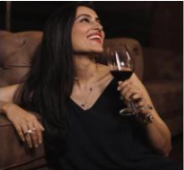
BUYER PERSONA
DISHA KAPOOR
Disha belongs to an elite family but she thrives to be independent so she lives in a rented apartment closer to her workplace. She has a car but she commutes to work through metro to avoid traffic. She is climbing the career ladder with dream and expectations. Her shopping bag consists of products at different price range. She doesn’t mind spending extra for products that not just make her look good but also doesn’t damage her skin. She shops at the mall but indulges in online shopping when impulse buying. She relies on various online channels for making purchase decisions.
Age
28 years old
Gender
Female
Place
Delhi, India
Studies
BSc in Chemistry, MBA from SP Jain Institute
Job
HR at Tata Communication
Salary
$60,000 annually

Slide 7
ANALYZING THE COMPETITION
Purplle
Sephora
Myntra
Amazon
Nykaa has much more Revenue and customer base than Purplle
Sephora although a global leader, Indian market is filled with Nykaa customers
Myntra can be compared with Nykaa on the basis of E-commerce industry. But the beauty & cosmetic segment precisely is still lead by Nykaa
Amazon is also globally big but in India especially the beauty market Nykaa steals the charm
379K
476K (SEPHORA INDIA)
1.5M
1.2M (INDIA)

Slide 8
OBJECTIVES of the CAMPAIGN
BEAUTY AT YOUR DOORSTEP
Sales
Awareness
Increasing the sales of the chemical-free
& natural In-house products of Nykaa thereby increasing revenue share of Nykaa Naturals in Nykaa which is at present 10%.
Spread the awareness of staying home, sanitized & beautiful and to be acknowledge the brave frontline warriors.

Slide 9
The CAMPAIGN - BEAUTY AT YOUR DOORSTEP
COVID stories
ONE for ONE
Email us your pandemic stories, how you survived the quarantine and managed to overcome the odds with #Brave&Beautiful
With one purchase the consumer impacts one poor family who get free set of Nykaa hand sanitizers and masks to stay sanitized
BUY
Order Nykaa Naturals Combo’s and get a Promo code
Free LIVE Entertainment
UPLOAD
We will upload the best of the stories on our page and acknowledge all women from different sectors and how did they battle the pandemic
This is the best part for the customer, the promo code avails them to join Nykaa Sunday live sessions with the best of comedians and experts on beauty and fashion

Slide 10
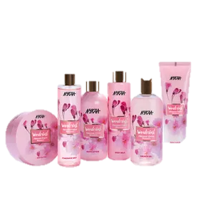
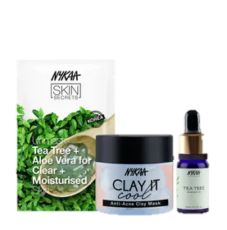
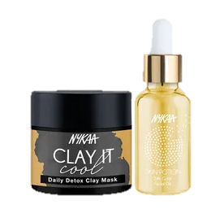
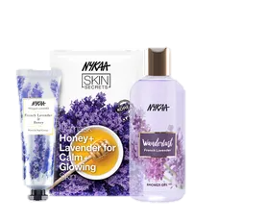
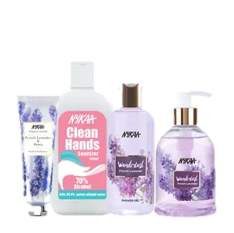
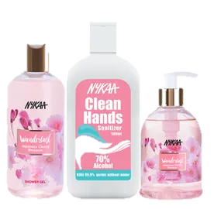
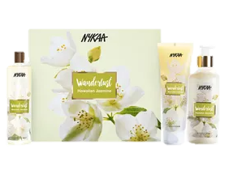
Combos on Offer

Slide 11
Every Sunday starting from 21st June
Every Tuesday & Thursday from 16th June
TIMELINE – JUNE 2020
Same sequence will continue till atleast two weeks and results will predict further campaign
Nykaa Sunday Specials
Social Media Posts
Influencer’s Posts
Comedians/experts posts
Every Monday, Wednesday & Friday from 15th June
Every Saturday prior to their show from 20th June

Slide 12
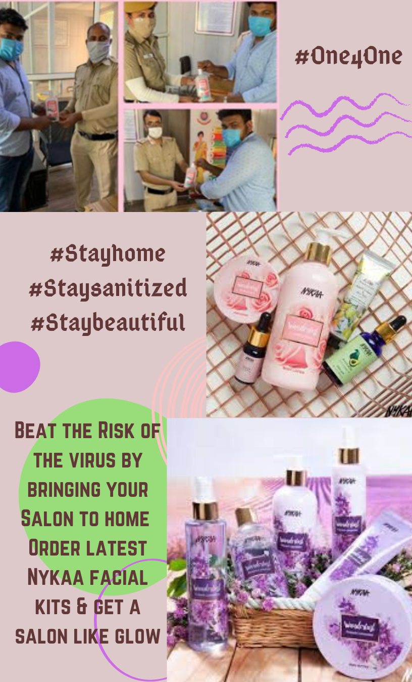
CONTENT WE ARE GOING TO CREATE
We will also be including video advertisements on YouTube & Hotstar

Slide 13
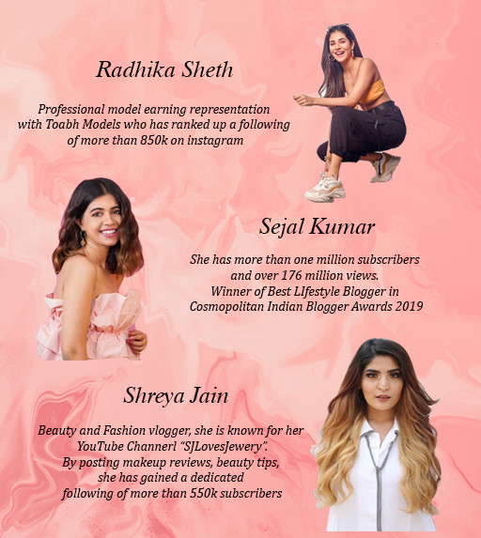
INFLUENCER MARKETING & ORM
All these top influencers and more like Mridul Sharma, Mrunal Panchal, Aashna Shroff will be posting a video/IGTV on their social media accounts on specified dates thus lowering our Social Media budget and covering more audience.
On top of this the respective week’s speakers/artists will also be posting on their own social media to attract audience from their Fan Base too. For example – Atul Khatri , Masaba Gupta, Aditi Mittal , Bodyshop , Aakash Gupta, Katrina Kaif, and many more.
We will also be looking forward to provide personalised replies on our Twitter account and maintain the goodwill & reputation of our brand.

Slide 14
Estimated Impact
Diverting the budget from offline advertising to online digital marketing will increase the impression during the lockdown period
As 90% of Nykaa's sales happen online, it did not face a major impact amidst lockdown except for delayed deliveries
The current Average Cost per Click as per Facebook analytics is around ₹ 0.69 with an average click-through rate of 1.23% and an average conversion rate of 6.97%.
As per reports from Business Today, the time spent online on Social Media has increased by 87%, with 4 hours on avg. time spent per day
Nykaa's revenue increased by 80% from FY2018 to FY2019 i.e $ 157 million. We expect to have a positive impact of our campaign by retention of our existing customers, this will provide us a modest increase in revenue by 20% to 25% during the lockdown and post lockdown period.
Customer Avg acquisition cost | ₹ 200.00
Customer Retention Rate | 75%
Customer Churn Rate | 25%
Average Lifetime in years | 4
Avg value of Sale/customer | ₹ 1,200.00
Avg Profit Margin/Customer | ₹ 300.00
Customer Lifetime Value (CLV) | ₹ 1,000.00

Slide 15
Awareness
Engagement
Conversion
Delight
Shift in Medium
Product
Awareness through reviews and online communities
Customer Engagement with Brand/product online
Customer buying the product online
Customer will review the product online and become the promoter for Nykaa
Product
Awareness through Search Engine/social media
Customer will participate in online campaign to promote our brand
Product
Awareness
Staying safe and healthy, while avoiding physical contact
Customer Engagement with Brand/product offline, via stores and local shops
Product
Awareness through friends, families and offline marketing
Visiting stores for a physical feedback and trials, getting exposed to COVID-19
Customer buying the product offline, in stores and shopping centres
Best Possibility
Good Possibility
Worst Possibility

Slide 16
CAMPAIGN BUDGET
Keeping the increment in budget year by year the same the marketing budget for the year 2020 will be 180CR out of which this campaign’s budget would be 5CR
67% Social
Media Marketing
5% Influencer Marketing
5,00,00,000
All Amt in Cr.
Year | 2019 |  | 2020
Website Management | ₹ 26.00 |  | ₹ 35.00
Online Commericals
Google Ads
Instagram | 55.0% | ₹ 52.88 | 55.00% | ₹79.75
Facebook | 7.0% | ₹ 6.73 | 10.00% | ₹14.50
Youtube | 10.0% | ₹ 9.61 | 10.00% | ₹14.50
Direct Mail | 3.0% | ₹ 2.88 | 2.00% | ₹ 2.90
Billboards | 7.0% | ₹ 6.73 | 0.00% | ₹ -
Newspapers | 3.0% | ₹ 2.88 | 0.00% | ₹ -
Magzines | 5.0% | ₹ 4.81 | 3.00% | ₹4.35
PR Events | 10.0% | ₹ 9.61 | 0.00% | ₹-
PR Events (online) | 0.0% | ₹ - | 10.00% | ₹14.50
Hotstar ads | 0.0% | ₹ - | 10.00% | ₹14.50
Total Social Media Marketing | 100.0% | ₹ 96.14 | 100.0% | ₹145.00
Total Marketing Cost | ₹ 122.14 |  | ₹ 180.00
20% Streaming Platforms ads
8% Comedians & expert’s Fees

Slide 17
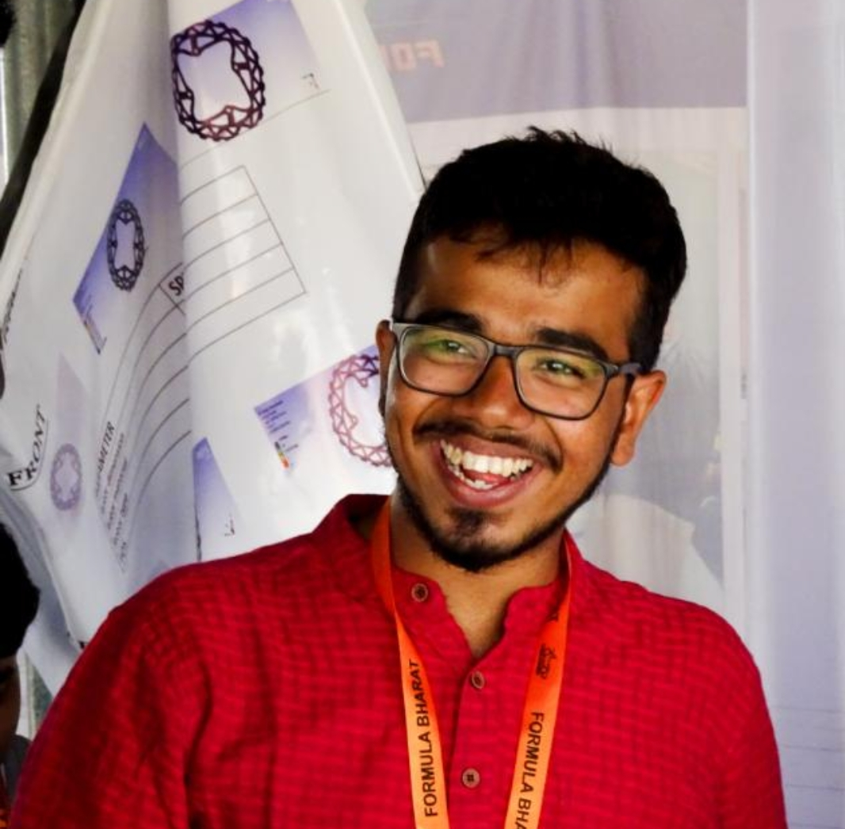
Team SYNERGY
KSHITIKA GALA
Sardar Patel College of Engineering
Mechanical Engineering
ARCHIT KATARE
Sardar Patel College of Engineering
Mechanical Engineering

